Slide 1
American History Bell Work
Wednesday, March 16th
Open your book to page 370 and read the quote, “Audie Murphy, American Hero.”
According to the Medal of Honor Citation, what was heroic about Murphy’s actions?

Slide 2
Chapter 11, Section 3
Victory in Europe and the Pacific

Slide 3
Planning Germany’s Defeat
Operation Overlord
    Throughout 1943. Roosevelt, Churchill, and Stalin disagreed about if they would start a second front in France
    Churchill argued that the German U-boat presence was too great in the English channel and that the Allies needed more land craft, more equipment, and better trained soldiers

Slide 4
Planning Germany’s Defeat
Operation Overlord
    November 1943 – Tehran Conference
        Roosevelt, Churchill, and Stalin meet in Tehran, Iran
        FDR sided with Stalin, and Churchill reluctantly agreed
        The massive Allied invasion of France given the code name Operation Overlord

Slide 5
D-Day Invasion of Normandy
Eisenhower Plans the Invasion
    Operation Overlord involved landing 21 American divisions and 26 British, Canadian, and Polish divisions on a 50-mile stretch of beaches in Normandy.
    The plan involved an elaborate deception (Operation Fortitude)
        Allies created a fictional army, with a fake headquarters southeast of Normandy

Slide 6
D-Day Invasion of Normandy
Inflatable tank used in Operation Fortitude

Slide 7
D-Day Invasion of Normandy
Heroes Storm the Beaches
    June 6, 1944: D-Day
        Plan was to strike five beaches, code named Utah, Omaha, Gold, Juno, and Sword
        First troops landed at 6:30 a.m.
        Four beaches had light opposition, but the Germans had dug trenches and built concrete structures to fire heavy artillery from at Omaha
            Omaha was assigned to American forces

Slide 8
D-Day Invasion of Normandy
Map of the D-Day invasion of Normandy, France

Slide 9
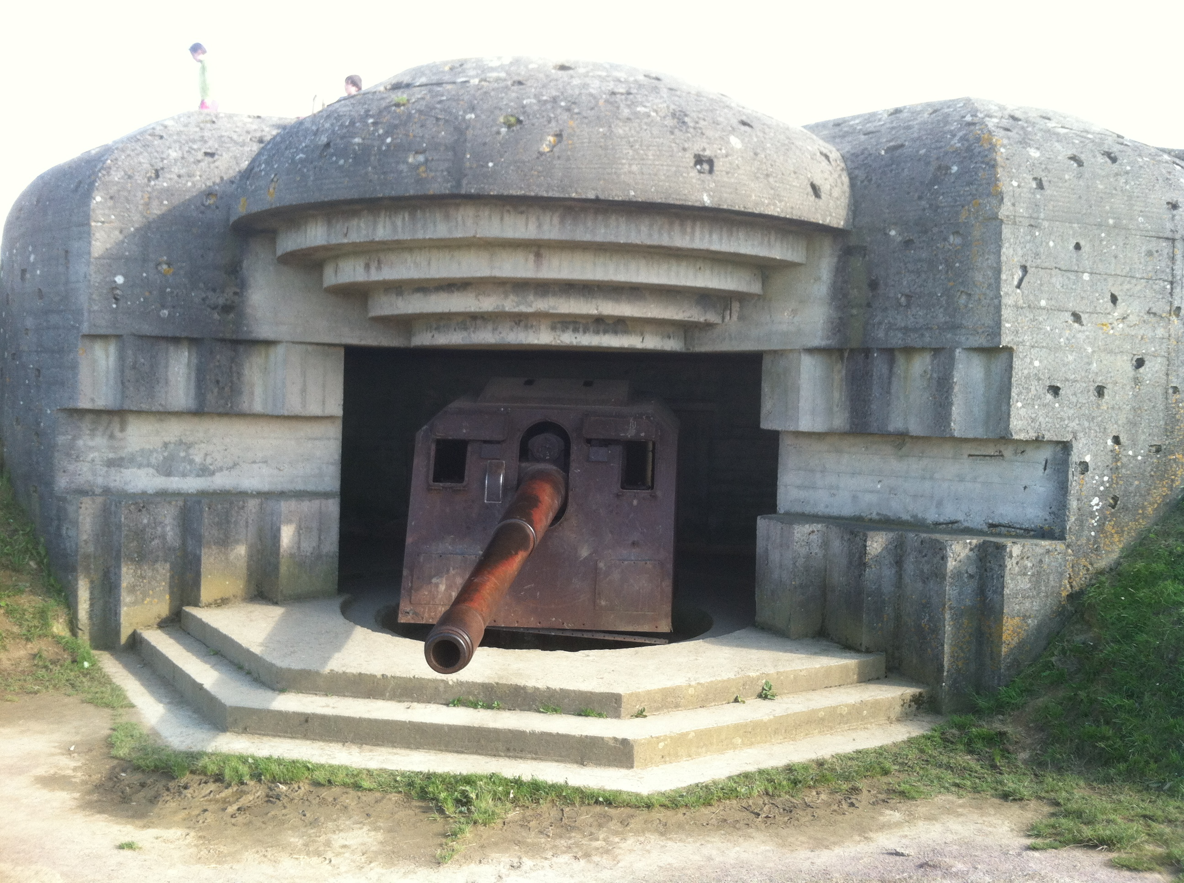
D-Day Invasion of Normandy
German “pillbox” overlooking the English Channel

Slide 10
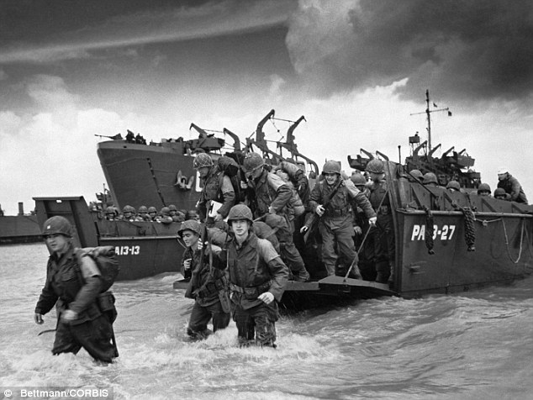
D-Day Invasion of Normandy
Soldiers landing on the beaches of Normandy
Notes:
Germans had heavily mined the beaches.
Water in English Channel was very rough.
Some crafts unloaded too far from the beach and soldiers drown.
On the beach it was a rainstorm of bullets and shells.

Slide 11
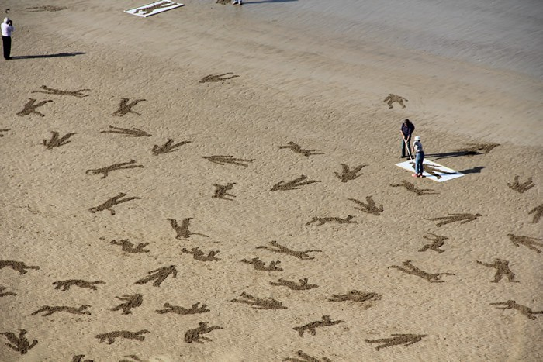
D-Day Invasion of Normandy
September, 2013
Artist depicts lives lost on the beaches on Normandy by stenciling life-size bodies on the beach.

Slide 12
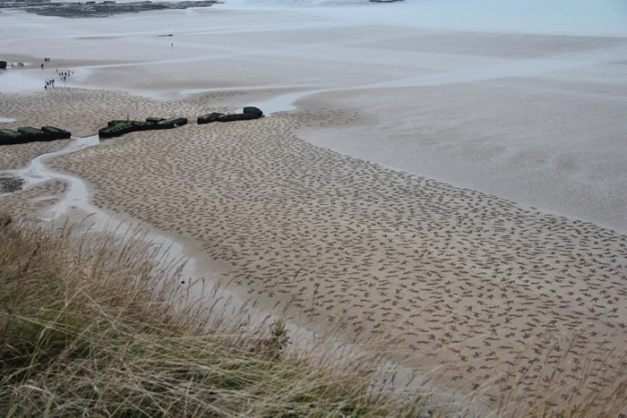
D-Day Invasion of Normandy
9,000 civilian, German, and Allied lives were lost on June 6, 1944

Slide 13
D-Day Invasion of Normandy
“I remember the bullets flying over our craft and seeing the ricochets of the bullets hitting the water. The landing craft’s door fell open and we ran into the surf. We were in very deep water and I thought I was going to drown or be shot before getting on land. By the grace of God, I made it ashore and started running through the deep water toward the seawall.”
  -Jack Fox, combat medic

Slide 14
Liberation of Europe
Allies Advance
    D-Day was the beginning of the end for Nazi Germany
    Soviet soldiers worked from the east to force the German armies out of eastern Europe
    August 1944 – Allies liberated Paris
    July 1944 – Rommel (German field marshal) plotted against Hitler, bombed Hitler’s headquarters, and took poison to escape being put on trial

Slide 15
Liberation of Europe
Germany Counterattacks
    Battle of the Bulge
        December 1944 – English speaking German soldiers in U.S. uniforms cut telephone lines, changed road signs, and spread confusion
        Caught the Allies by surprise and captured several key towns
        Once reinforcements arrived, Germany was once again being pushed out of France

Slide 16
Liberation of Europe
Allies Push to Victory
    April 1945 – Mussolini tries to flee to Switzerland, but is captured and executed
    Allied forces now cross into Germany
    Hitler gives orders no one follows
    April 30, 1945 - Hitler commits suicide
    May 7, 1945 - V-E Day (Victory in Europe) Germany surrenders

Slide 17
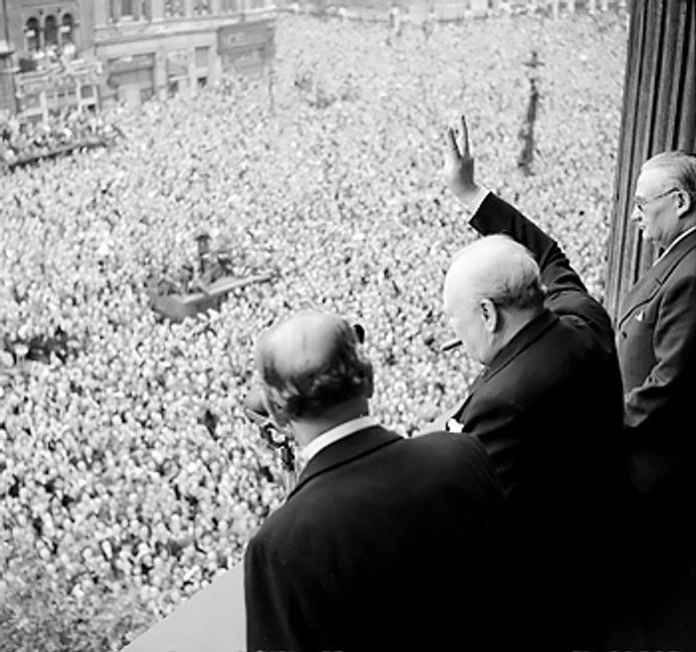
Liberation of Europe
Winston Churchill waves to crowds in London on the day he broadcast the news that the war with Germany was over.

Slide 18
Advancing in the Pacific
Japanese Troops Fight to the Death
    While the war raged in Europe, American forces were island-hopping in the Pacific
    Each island was a fight to the death
    Many Japanese troops killed themselves instead of surrender
    Japanese kamikaze pilots deliberately crashed into American ships
    General McArthur took back the Philippines

Slide 19
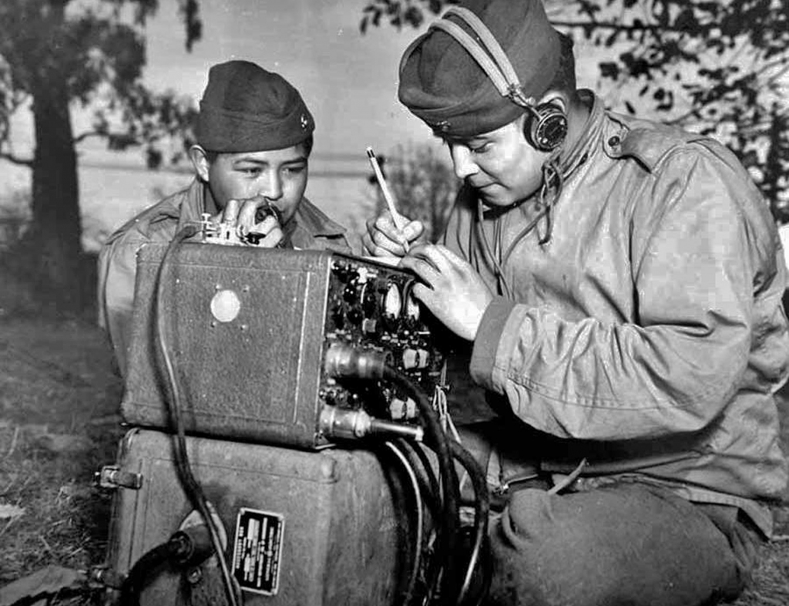
Advancing in the Pacific
Navajo Code Talkers

Slide 20
Advancing in the Pacific
American Forces Near Japan
    February & March 1945 – Iwo Jima
        U.S. Marines faced a dug-in enemy for 36 days
        23,000 Marine casualties
        Americans took the island
    April 1945 – Okinawa
        Contained a vital airbase
        Involved half a million troops & 1,213 warships

Slide 21
Advancing in the Pacific
What might have happened if Japan took Midway and Hawaii early in the war?

Slide 22
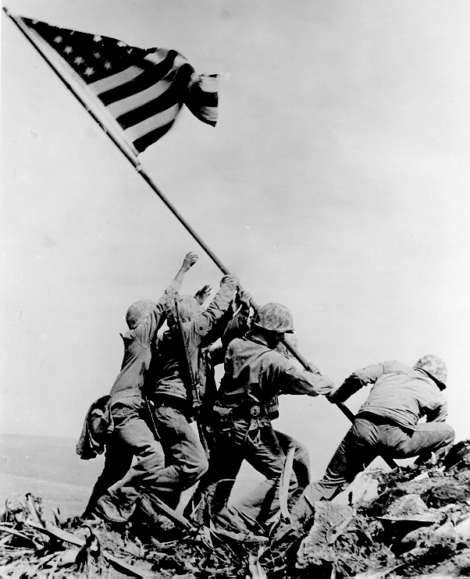
Advancing in the Pacific
Raising the flag on Iwo Jima
Three of the five men were killed in action over the next few days of fighting.

Slide 23
The Atomic Bomb Ends the War
The Manhattan Project Develops the A-Bomb
    Early 1930s – scientists learned how to split the nuclei of certain elements, discovering the process of nuclear fission
    Manhattan Project – code name for development of atomic bomb
        Cost several billion dollars and employed tens of thousands of people

Slide 24
The Atomic Bomb Ends the War
The Manhattan Project Develops the A-Bomb
    Leaders – General Leslie Groves and J. Robert Oppenheimer
        Groves secured buildings, materials, scientists, and security
        Oppenheimer ran the scientific aspect
    Project included many refugees from Europe
    July 16, 1945 – outside Alamogordo, New Mexico, first atomic bomb tested

Slide 25
The Atomic Bomb Ends the War
U.S. and Canadian sites important to the Manhattan Project

Slide 26
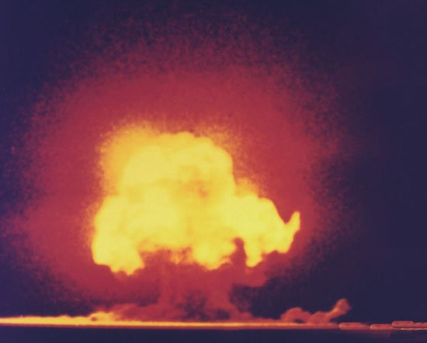
The Atomic Bomb Ends the War
“Now I become Death, the destroyer of Worlds”
-Oppenheimer
Notes:
Columbus, Ohio is 200 miles away from Detroit, which is approximately 3 and ½ hours away.
You could see the test of the first atomic bomb 180 miles away from the test site.

Slide 27
The Atomic Bomb Ends the War
Truman Makes His Decision
    FDR had died a few weeks before V-E Day, the new President, Harry Truman, had to make the decision to use the atomic bomb.
    Truman had to weight the options – use the bomb against civilians, knowing the Axis powers had nuclear scientists
    Ultimately, Truman decided to save American lives.

Slide 28
The Atomic Bomb Ends the War
Hiroshima and Nagasaki Are Destroyed
    August 6, 1945 – U.S. pilots dropped a bomb on Hiroshima at 8:15 a.m.
        Two minutes later, 60,000 residents dead or missing
        Japanese leaders debate whether to surrender
    August 9, 1945 – Soviets invade Manchuria and U.S. drops a second atomic bomb on Nagasaki

Slide 29
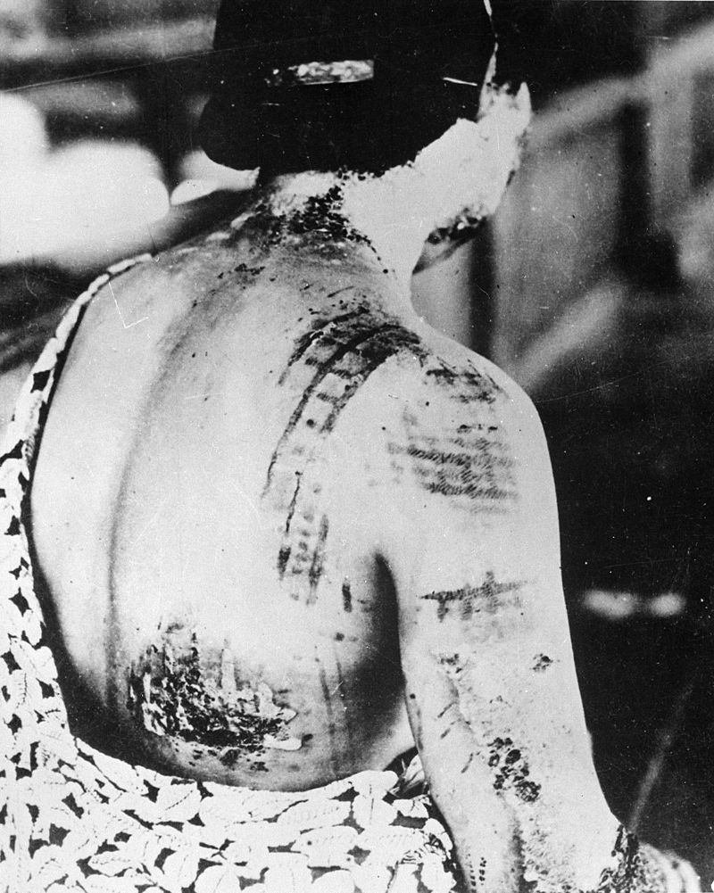
The Atomic Bomb Ends the War
A victim of the atomic bombing of Hiroshima. She suffered severe burns. The pattern on her skin is from the kimono she was wearing at the time of the bombing.

Slide 30
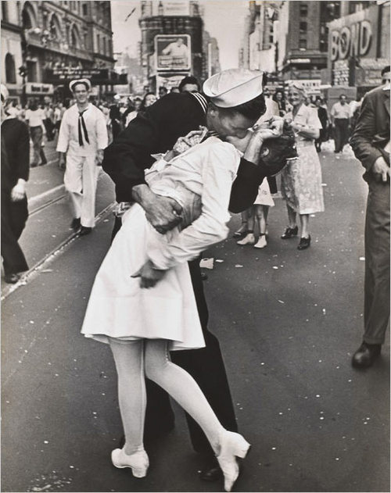
The Atomic Bomb Ends the War
V-J Day in Times Square
August 15, 1945 Emperor Hirohito surrenders

