Slide 1
American History Bell Work
Monday, March 28th
First, pick up a new Bell Work log from the table.
Second, open your book to page 386 and silently read the two paragraphs under, “Witness History: Nazism on Trial”
Third, answer this question: According to Robert Jackson, what might happen if people do not learn from the Holocaust?

Slide 2
Chapter 11, Section 5
Effects of the War

Slide 3
Allies Set Postwar Goals
Allies Make Plans at Yalta
  Yalta Conference: In February 1945, Roosevelt, Churchill, and Stalin met on the Black Sea to discuss postwar Germany, Eastern Europe, and Asia. FDR also wanted Stalin to enter the war against Japan.
      Agreed that Poland, Bulgaria, and Romania would hold free elections; Stalin went back on this promise.

Slide 4
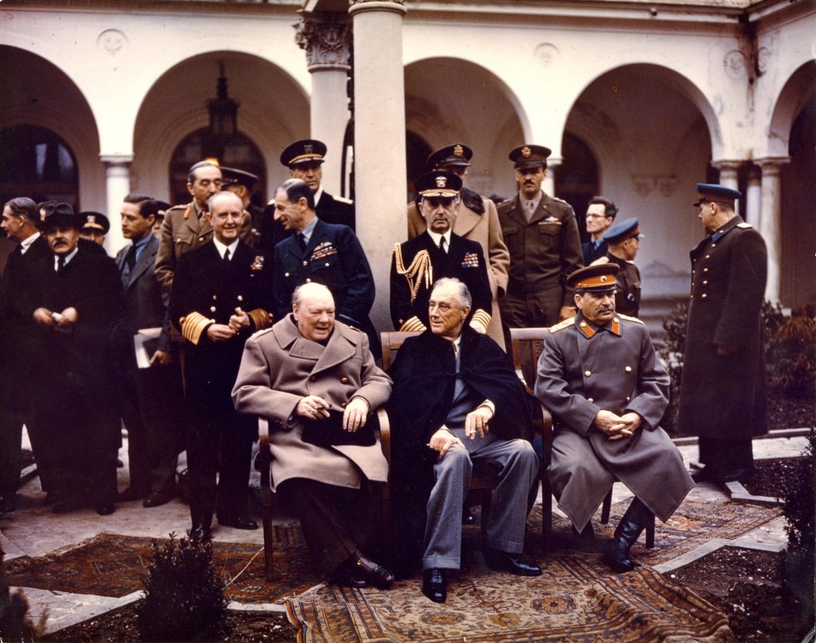
Allies Set Postwar Goals
The Big Three at the Yalta Conference
Left to Right:
Winston Churchill
Franklin D. Roosevelt
Joseph Stalin

Slide 5
Allies Set Postwar Goals
Truman Faces Stalin at Potsdam
  July 1945
    “Big Three” met in Berlin suburb of Potsdam
      Truman replaced FDR as President of the U.S.
      Atlee replaced Churchill as Prime Minister of G.B.
      Stalin still in power of U.S.S.R.
      Decide to split Germany into four zones: Soviet, American, British, and French
      Agreed to new boarders for Poland
      Stalin pledges to enter war against Japan

Slide 6
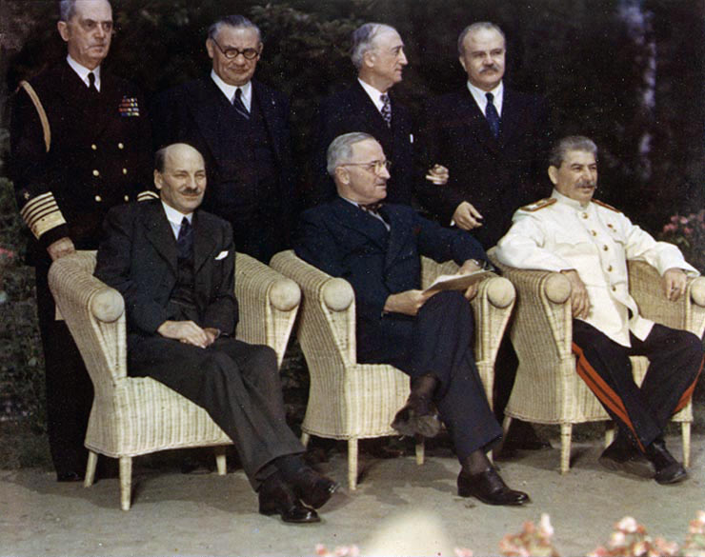
Allies Set Postwar Goals
The Big Three in Potsdam, Germany
Left to Right:
Clement Attlee
Harry S. Truman
Joseph Stalin

Slide 7
A New World Takes Shape
The World Map Changes
  Borders of Poland shifted to the west
  Germany split into communist East Germany and noncommunist West Germany
  In Japan, General Douglas MacArthur headed an American military occupation and rewrote their constitution.
    Abolished armed forces
    Gave women the right to vote
    Established groundwork for full economic recovery

Slide 8
A New World Takes Shape
Imperialism Goes into Decline
  WWII marked the end of Western European domination of the world.
    East Indies did not want to return to Dutch rule
    Indochina did not want to see the return of France
    India, Burma, and colonies in the Middle East and Africa all had their sights set on independence

Slide 9
The Decline of Imperialism, 1945-1989
Notes:
Map Skills:
Locate:
Europe
Africa
Asia
The Soviet Union
On what continent did the largest number of nations win independence?
How might the appearance of so many new nations affect the balance of power in a postwar world?

Slide 10
A New World Takes Shape
The Balance of Power Shifts
  Superpowers: powerful country that plays a dominant economic, political, and military role in the world
    The United States and the Soviet Union became superpowers after WWII.
      U.S.A. – no attack on U.S. soil, industry boomed, but had the atomic bomb
      U.S.S.R – much of the war was fought on their soil, industries, cities, and people had suffered terribly, but the Red Army was the world’s largest military force

Slide 11
International Cooperation
A New World Economy Takes Shape
  United States = responsibility to shape the postwar world economy
    International Monetary Fund & World Bank: U.S. provided money for loans to help stabilize other countries
    General Agreement on Tariffs and Trade (GATT): A 1948 treaty designed to expand world trade by reducing tariffs

Slide 12
International Cooperation
The United Nations is Formed
  United Nations: Created to promote international cooperation.
    Promotes international peace and security
    Economic development
    Protecting the environment
    Providing humanitarian aid in cases of famine, natural disaster, and armed conflict

Slide 13
International Cooperation
The United Nations is Formed
  Universal Declaration of Human Rights: Declaration by the United Nations; condemns slavery and torture, upholds freedom of speech and religion, and that “everyone has the right to a standard of living adequate for the health and well being of himself and his family.”
    Lofty goals = difficult to enforce

Slide 14
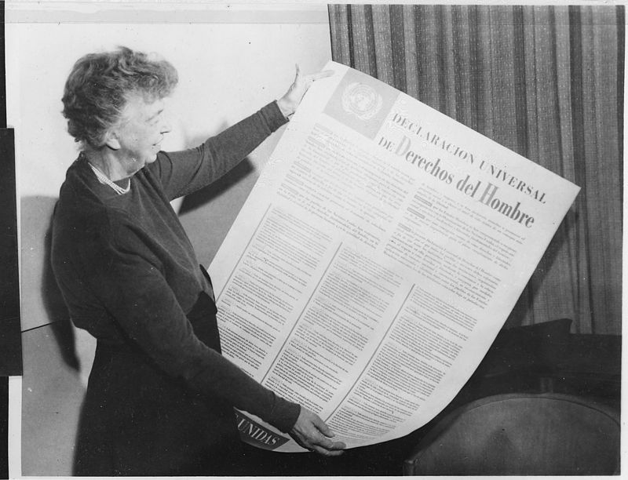
International Cooperation
Eleanor Roosevelt and the United Nations Universal Declaration of Human Rights in Spanish
Notes:
After FDR’s death, President Truman named Eleanor Roosevelt to represent the United States at the United Nations. She guided the drafting of the Universal Declaration of Human Rights. Her work on behalf of human rights gave Eleanor the nickname, “First Lady of the World.”

Slide 15
International Cooperation
War Criminals Go on Trial
  Geneva Convention: An international agreement governing the humane treatment of wounded soldiers and prisoners of war.
    Breaches of the Geneva Convention:
      Killing, torture, or inhuman treatment, including experiments
      forcing a protected person to serve in the armed forces of a hostile power
      extensive destruction of property not justified militarily necessary

Slide 16
International Cooperation
War Criminals Go on Trial
  Prime Minister Tojo condemned to death for the Bataan Death March
  Nuremberg Trials: Allied prosecution of Nazis for war crimes.
    All defendants were given IQ tests and psychiatric evaluations
    Judges did not believe when people testified that they were just following Hitler’s orders
    Continued for decades
Notes:
https://en.wikipedia.org/wiki/File:1946-10-08_21_Nazi_Chiefs_Guilty.ogv

Slide 17
A New American Identity
The United States Assumes Global Leadership
  Few Americans called for a return to a policy of isolationism.
    Recognized that what happened in the far reaches of the globe affected them.

Slide 18
A New American Identity
Commitment to Civil Rights Grow
  WWII gave a renewed vigor to the fight for civil rights
  Americans call for the nation to fully live up to its promise of freedom, democracy, and justice

Slide 19
A New American Identity
The Nation Prospers
  WWI:
    Ended the Great Depression
    Defense industries and military bases in the South and the West spurred people to move to these regions

