Slide 1
American History Bell Work Monday, March 14th
Pick up a new Bell Work log on the table next to the mailboxes.
Why was rationing important during WWII?

Slide 2
WWII Rationing Simulation
The Home Front

Slide 3
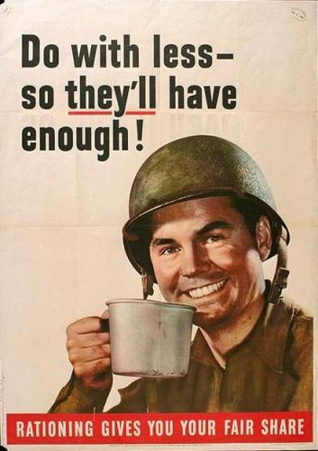
Even in the depths of the Depression, there was enough to eat, if only you could afford to buy it.
As soon as the U.S. entered the war in the winter of 1941-42, shortages began.
By 1943, it had become every citizen’s duty to cut back to “they’ll have enough.”
Notes:
http://www.learnnc.org/lp/editions/ww2-rationing/5934
GO BACK TO THIS WEBSITE LATER TO ADD TO THIS POWERPOINT

Slide 4
The military needed huge amounts of food to feed soldiers.
Meat was in especially short supply.
The government limited the amounts shipped to grocers and restaurants and set a “voluntary ration” of two and a half pounds of red meat per adult per week, but stores often could not even get that much.

Slide 5
Asking civilians to conserve food didn’t do enough.
In early 1943, the Office of Price Administration introduced a system for rationing canned goods.

Slide 6
Food shortages pushed prices up.
The government combined rationing with price controls (limits on what people could charge for various goods) in hopes of keeping the cost of living reasonable.
This poster urged people not to undermine price controls by paying premiums for black-market goods outside the rationing system.

Slide 7
People could avoid the limits imposed by rationing by planting “victory gardens.”
20 million Americans planted gardens in their backyards, in empty lots, and on the rooftops of city buildings.

Slide 8
Planning Your Meals
Today we are going to create a week’s worth of meals based on food stamp rations.
Get out a piece of paper and prepare to write things down …

Slide 9
Planning Your Meals
16 Red Stamps
Meat, butter, cheese, sugar, and oil
48 Blue Stamps
Canned foods

Slide 10
WWII era food pyramid

Slide 11
Vegetable
serving size:
3 ounces
One POUND =
16 ounces
Fruit
serving size:
5 ounces
Juice & Soup
serving size:
8 ounces

